Slide 1
Java Dave eNVIRONMENT
Introduction of Dev environment, GIT/Maven;
Java workshop training, August,2017.
Dr. Kishore Biswas (Forrest/柯修)
PhD. Artificial Intelligence—Natural Language Processing.
CanWay IT Training ®.

Slide 2
Contents
Introduction of Java Development environment/tools
GIT & GIT Hub
3) Maven

Slide 3
1) Introduction of Java Development environment/tools

Slide 4


Our Environment
you and me
output
Development Environment
BlueJ.exe, jEdit, jPad, command line
text editor
BlueJ, jEdit, notepad.exe, …
compiler
javac.exe
java virtual machine (JVM)
java.exe
class definition
source file: Dog.java
class definition
binary file: Dog.class

Slide 5
Us
you and me
the programmer
output
Development Environment
BlueJ.exe, jEdit, jPad, command line
text editor
BlueJ, jEdit, notepad.exe, …
compiler
javac.exe
java virtual machine (JVM)
java.exe
class definition
source file: Dog.java
class definition
binary file: Dog.class

Slide 6
Development Environment
you and me
our development environment
output
Development Environment
BlueJ.exe, jEdit, jPad, command line
text editor
BlueJ, jEdit, notepad.exe, …
compile it
run it
compiler
javac.exe
edit the source code
java virtual machine (JVM)
java.exe
class definition
source file: Dog.java
class definition
binary file: Dog.class

Slide 7
Source code (we write this)
you and me
output
Development Environment
BlueJ.exe, jEdit, jPad, command line
text editor
BlueJ, jEdit, notepad.exe, …
compiler
javac.exe
java virtual machine (JVM)
java.exe
class definition
source file: Dog.java
class definition
binary file: Dog.class
source code

Slide 8
Java compiler and virtual machine
you and me
output
Development Environment
BlueJ.exe, jEdit, jPad, command line
text editor
BlueJ, jEdit, notepad.exe, …
compiler
javac.exe
java virtual machine (JVM)
java.exe
class definition
source file: Dog.java
class definition
binary file: Dog.class
Java tools

Slide 9
Compile it
you and me
The compiler reads our source file
and produces a binary class file.
output
Development Environment
BlueJ.exe, jEdit, jPad, command line
text editor
BlueJ, jEdit, notepad.exe, …
compile it
compiler
javac.exe
java virtual machine (JVM)
java.exe
class definition
source file: Dog.java
binary class definition
class definition
binary file: Dog.class

Slide 10
Run it
you and me
The virtual machine executes the instructions
in the class definition to produce the output from
our program.
output
Development Environment
BlueJ.exe, jEdit, jPad, command line
text editor
BlueJ, jEdit, notepad.exe, …
run it
compiler
javac.exe
java virtual machine (JVM)
java.exe
class definition
source file: Dog.java
class definition
binary file: Dog.class

Slide 11
Total Platform Independence
JAVA COMPILER
(translator)
JAVA BYTE CODE
(same for all platforms)
JAVA INTERPRETER
(one for each different system)
Windows 95
Macintosh
Solaris
Windows NT
Notes:
1

Slide 12
Architecture Neutral & Portable
Java Compiler -Java source code to bytecode
Bytecode - an intermediate form, closer to machine representation
A virtual machine on any target platform interprets the bytecode
Porting the java system to any new platform involves writing an interpreter that supports the Java Virtual Machine
The interpreter will figure out what the equivalent machine dependent code to run

Slide 13




From Make to Gradle
GNU Make
Originally for building C/C++, Fortran (compiled and linked languages)
Platform specific builds (need Autoconf)
Apache Ant
Originated to build Tomcat in early 2000’s
Apache Maven
Originated from Jakarta Alexandria project 2001
Gradle (gradle.org)
Build automation from command line to IDE to Continuous Integration
Notes:
All can do incremental builds: compiles only the files that have been touched

Slide 14
Free IDE for Java Development & Programming
NetBeans
NetBeans is an open source Integrated Development Environment written in Java and is one of IDR Solutions’ favorite IDEs for Java coding. The NetBeans IDE supports development of all Java application types (Java SE, JavaFX, Java ME, web, EJB and mobile applications) out of the box. NetBeans is modular in design meaning it can be extended by third party developers who can create plugins for NetBeans to enhance functionality
Eclipse
Eclipse is another free Java IDE for developers and programmers and it is mostly written in Java. Eclipse lets you create various cross platform Java applications for use on mobile, web, desktop and enterprise domains.
Its main features include a Windows Builder, integration with Maven, Mylyn, XML editor, Git client, CVS client, PyDev, and it contains a base workspace with an extensible plug-in system for customizing the IDE to suit your needs. Through plugins you can develop applications in other programming languages some of which include C, C++, JavaScript,, Perl, PHP, Prolog, Python, R, Ruby (including Ruby on Rails framework), to name just a few. Eclipse is available under the Eclipse Public License and is available on Windows, Mac OS X and Linux.

Slide 15
The top 11 Free IDE for Java Coding, Development & Programming
IntelliJ IDEA Community Edition
IntelliJ IDEA Community Edition is a free Java IDE (Integrated Development Environment) mainly used for Android app development, Scala, Groovy, Java SE and Java programming. It is lightweight in design and comes with useful features like JUnit testing, TestNG, debugging, code inspections, code completion, support for multiple refactoring, Maven build tools, ant, visual GUI builder and code editor for XML and Java.
There are some features missing from the Community Edition but if you require more you can buy a license to unlock all the features. IntelliJ Idea Community Edition is is released under the Apache 2 License.
Eclipse
Eclipse is another free Java IDE for developers and programmers and it is mostly written in Java. Eclipse lets you create various cross platform Java applications for use on mobile, web, desktop and enterprise domains.
Its main features include a Windows Builder, integration with Maven, Mylyn, XML editor, Git client, CVS client, PyDev, and it contains a base workspace with an extensible plug-in system for customizing the IDE to suit your needs. Through plugins you can develop applications in other programming languages some of which include C, C++, JavaScript,, Perl, PHP, Prolog, Python, R, Ruby (including Ruby on Rails framework), to name just a few. Eclipse is available under the Eclipse Public License and is available on Windows, Mac OS X and Linux.

Slide 16
The top 11 Free IDE for Java Coding, Development & Programming
Android Studio
Android Studio from Google is mainly designed for developing on the Android Platform. However it is capable of running and editing some Java code.
Enide Studio 2014
Enide Studio 2014 (version 0.11-preview) was initially released as a stand-alone product for all operating systems. However later changes saw it develop a Tool Suite for Node.js, JavaScript and Java Development which is available from the Eclipse plugin store and from the main website.
BlueJ
BlueJ is an integrated development environment (IDE) for the Java programming language. It has been mainly developed for educational purposes, but is also suitable for those who wish to do small-scale software development. It runs with the help of a JDK (Java Development Kit). BlueJ is mainly developed for the teaching of object-oriented programming, and its design differs from other development environments as a result.

Slide 17
The top 11 Free IDE for Java Coding, Development & Programming
jEdit
jEdit is a text editor with hundreds (counting the time developing plugins) of person-years of development behind it. Most people argue where jEdit beats many expensive development tools for features and ease of use is that the jEdit core comes with a built-in macro language; an extensible plugin architecture. Hundreds of macros and plugins are available.
jGRASP
jGRASP is a lightweight IDE primarily created for automatic generation of software visualizations to improve the comprehensibility of software. It is capable of producing static visualizations of source code structure and visualizations of data structures at runtime and jGRASP produces Control Structure Diagrams (CSDs) for Java, C, C++, Objective-C, Python, Ada, and VHDL; Complexity Profile Graphs (CPGs) for Java and Ada; UML class diagrams for Java; and has dynamic object viewers and a viewer canvas that work in conjunction with an integrated debugger and workbench for Java.
JSource
JSource is a free Java IDE and is a good option for Java developers and programmers. It is useful for creating cross-platform Java applications for various domains and is extremely lightweight. You can use JSource to run, compile, edit and create Java files. Its main features are syntax highlighting for multiple languages and Java Swing components. In version 2.0 of JSource you can use jEdit syntax packages and can incorporate other open source Java tools used for rapid development. These tools have been modified to work with the core JSource structure.

Slide 18
The top 11 Free IDE for Java Coding, Development & Programming
JDeveloper
JDeveloper is an IDE supplied by the Oracle Corporation and released as freeware. It offers various features for development in Java, XML, SQL and PL/SQL, HTML, JavaScript, BPEL and PHP. JDeveloper can be used for coding, debugging, optimization and profiling to deploying. JDeveloper integrates with the Oracle Application Development Framework (Oracle ADF) – an end-to-end Java EE-based framework that further simplifies application development.
DrJava
DrJava is an extremely lightweight development environment that can be used for writing Java programs. It has been designed primarily for students, and provides an intuitive interface and the ability to interactively evaluate Java code.

Slide 19
Tools - javac
javac.exe is the Java compiler from Sun
javac converts your X.java file to X.class file
located in the Java directory tree
C:\apps\jdk140\bin\javac.exe
Operating system must be able to find compiler
set PATH variable so that it includes <java>\bin
Settings -> Control Panel -> System -> Advanced
then select Environment Variables
add or edit PATH

Slide 20
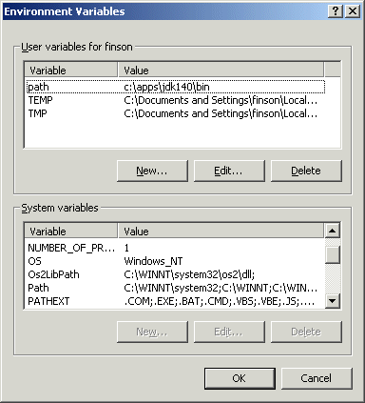
path example

Slide 21
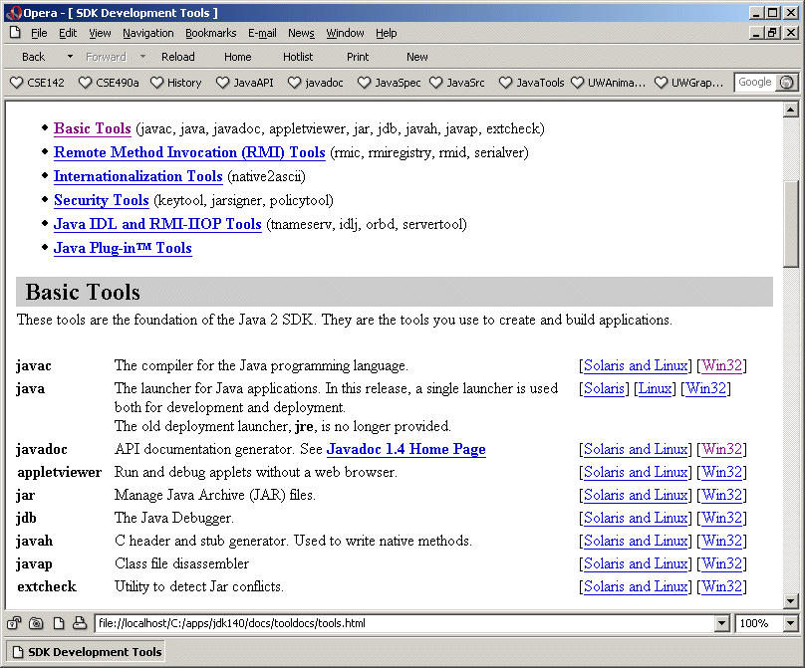
tools documentation

Slide 22
Classpath
Compiler must be able to find other classes that we use
Standard java classes found by the default setup
Special classes like uwcse Shape must be located
in BlueJ we set uwcse.jar as a user library
when running java ourselves we set the library as part of the class path
Classpath tells the compiler where to look
javac -classpath .;\cse\lib\uwcse.jar *.java

Slide 23
Tools - java
java.exe runs the Java virtual machine from Sun
the virtual machine reads your class files and actually runs the program you’ve written
java.exe is located in the Java directory tree
C:\apps\jdk140\bin\java.exe
Operating system must be able to find java.exe
Path should be set already for the compiler

Slide 24
Launching a java program
The java tool launches a Java application. It does this by
starting a Java runtime environment
loading a specified class
invoking that class' main method.
The method declaration must look like the following:
public static void main(String args[])

Slide 25
Classpath
Just as with the compiler, java must be able to find other classes that we use in the program
Standard java classes found by the default setup
Special classes like uwcse Shape must be located
in BlueJ we set uwcse.jar as a user library
when running java ourselves we set the library as part of the class path
Classpath tells java where to look
java -classpath .;\cse\lib\uwcse.jar Director

Slide 26
Tools - File System
It is important that you be able to find the source files that you write and understand what they are and how they relate
Look at the directories
find the .java files and the .class files
Notice that the files that I supplied for homework 4 are in a subdirectory “skel”
they are part of package “skel” as a result
more about packages in later lectures

Slide 27
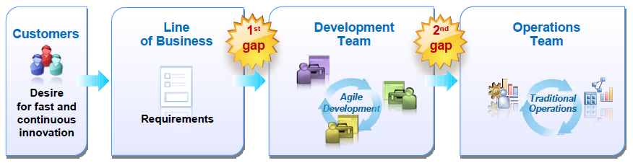
Delivery Challenges
Today’s business and technical needs are pushing traditional delivery approaches to the breaking point
Technical Challenges:Scale Complexity Time Pressures
Technical Trends: SoLoMo

Slide 28
Reduce Delivery Gaps
Design and Deployment Planning
Integrate and automate deployment planning processes across development & operations
Ensure asset & configuration details are shared and synchronized across asset stores.
Environment Setup, Testing,Deployment and Monitoring
Leverage integrated tools for discovery & accelerating provisioning of test lab & production environments.
Improving test performance by replicating “real world” environments - faster testing & problem resolution
Issue Identification and Resolution Management
Resolving problems quicker by sharing problem & ticket information
Ensuring tracking tools for production problems and application fixes remain synchronized

Slide 29
The Quotation on Programming language
“When human beings acquired language, we learned not just how to listen but how to speak. When we gained literacy, we learned not just how to read but how to write. And as we move into an increasingly digital reality, we must learn not just how to use programs but how to make them.”
Douglas Rushkoff

Slide 30
Types of Software
Application Software
Microsoft Word, Photoshop
Cell Phone Apps
Business Software
Inventory and Shipping control
Financial Analysis
Embedded Software
Cell Phone OS, iPod
car engine
Games
Notes:
Most of the money goes into the business software category. But, more and more money is going into running new personal devices.

Slide 31

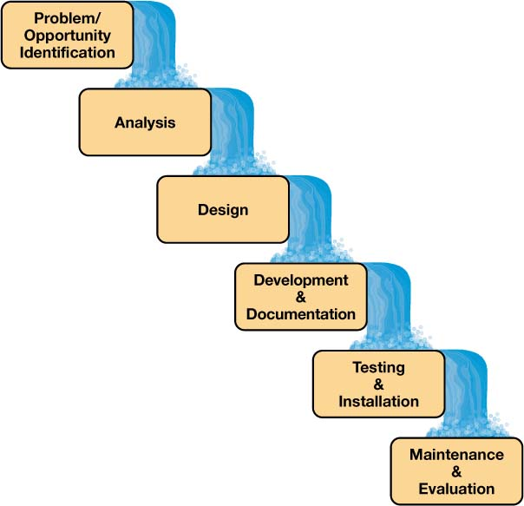


Creation of Software

Slide 32
Software Terminology
Algorithm:
set of steps that describe what the program must do
written in English
Programming:
turning an algorithm into an English-like language the computer can understand
there are lots of programming languages
also know as "coding"
Debugging:
Testing the software to find and remove errors
Notes:
This information is similar to what is in the book.
The main idea is that software developers use a series of tools to turn their algorithm into a runable program.

Slide 33
How Programming Works
Algorithm
Analyze the Problem
and Design a Solution
Programming
Program
Source Code
Development
Environment
Software Translates the Source Code
into Machine Code (1s and 0s)
Notes:
The main idea is that software developers use a series of tools to turn their algorithm into a runable program.

Slide 34
Example: average a list
Input:
an unknown amount of positive numbers
-1 to stop the list
Output:
the average
Processing:
read numbers until the user enters "-1"
total up all the numbers
print the average (total divided by count)
stop

Slide 35
The Algorithm
Prompt the user
Get First number
Is it -1
Yes
Print
total / count
No
add number to total
add one to count
Information to Track:
number that was input
count of numbers
total of all numbers
Get Next number

Slide 36
The Source Code
main ()
{
integer: value, count, sum;
print "Enter your numbers";
input value;
while (value <> -1)
sum = sum + value;
count = count + 1;
input value;
end while;
print "Average = ", sum/count;
}
Ask the OS
for memory
Prompt User
Get 1st number
Loop to add up the sum and count the number of inputs
Print the average

Slide 37
Testing the Program
Test #1:
input:
25
35
30
-1
output:
Average = 30
result:
test passed
Test #2:
input:
-1
output:
fatal error
result:
test failed
tried to print 0/0

Slide 38
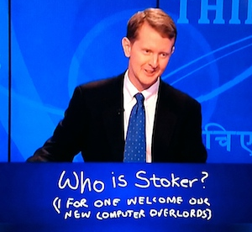
Specialties within Computer Science
Web Application Design
Networking and Computer Security
Graphics
Artificial Intelligence
Database Analysis
Watson, the Jeopardy playing supercomputer from IBM is a good example of AI
Notes:
This is a sales pitch for computer science as a major.

Slide 39
Future Software Trends
Continued Movement to the Web
Entertainment, Banking, Information
Handheld Devices
multi-media / intelligent / interconnected
Unknown
integration of devices

Slide 40
Improvements
Revision Control
Automation
Unit Testing
Issue Tracking
Documentation

Slide 41
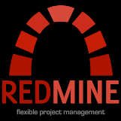



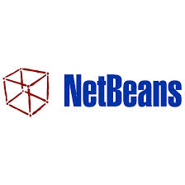



It ALL ties together…
Issue Management
Development
Build Automation
Unit Testing
Repository

Slide 42


2) GIT & GIT Hub

Slide 43
Version control systems
Version control (or revision control, or source control) is all about managing multiple versions of documents, programs, web sites, etc.
Almost all “real” projects use some kind of version control
Essential for team projects, but also very useful for individual projects
Some well-known version control systems are CVS, Subversion, Mercurial, and Git
CVS and Subversion use a “central” repository; users “check out” files, work on them, and “check them in”
Mercurial and Git treat all repositories as equal
Distributed systems like Mercurial and Git are newer and are gradually replacing centralized systems like CVS and Subversion

Slide 44
Why version control?
For working by yourself:
Gives you a “time machine” for going back to earlier versions
Gives you great support for different versions (standalone, web app, etc.) of the same basic project
For working with others:
Greatly simplifies concurrent work, merging changes
For getting an internship or job:
Any company with a clue uses some kind of version control
Companies without a clue are bad places to work

Slide 45
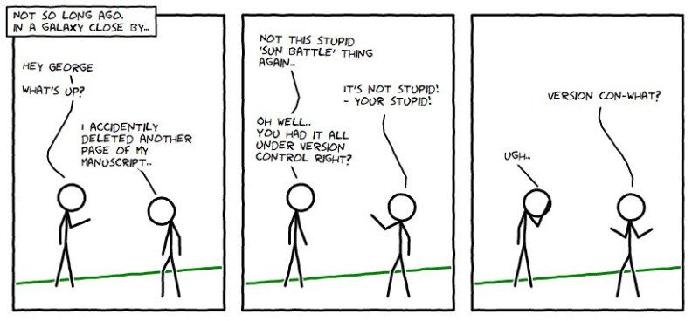

Slide 46
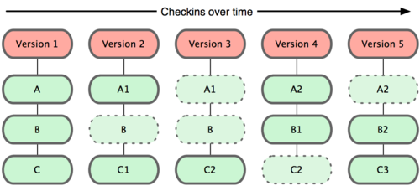
Git and versions

Slide 47
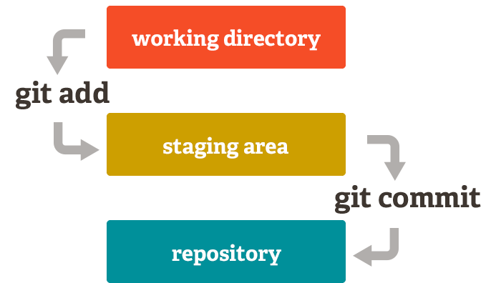

Slide 48
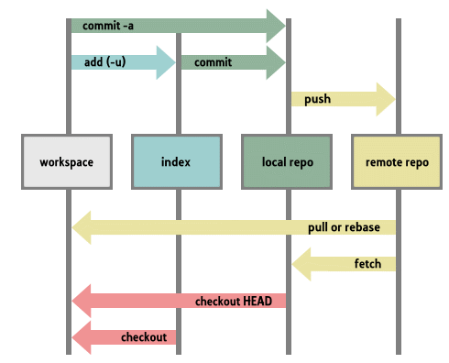

Slide 49
Why Git?
Git has many advantages over earlier systems such as CVS and Subversion
More efficient, better workflow, etc.
See the literature for an extensive list of reasons
Of course, there are always those who disagree
Best competitor: Mercurial
I like Mercurial better
Same concepts, slightly simpler to use
In my (very limited) experience, the Eclipse plugin is easier to install and use
Much less popular than Git

Slide 50
Why Source Control?
How do we make big or risky code changes without affecting the stable version?
How do we work on new versions and still support old versions?
Notes:
Feature branches.
Release branches.

Slide 51



Popular Tools
Notes:
P4 and SVN (subversion) are centralized. Git is distributed.
Git is separate from github, but github is popular for hosting.

Slide 52

Centralized
Server holds a centralized repository
Clients have a revision
Notes:
This follows P4.
The server has the entire repository (depot in P4) including history. Clients have a local snapshot.

Slide 53
Centralized
Notes:
This follows P4

Slide 54
Centralized
Submit
Notes:
This follows P4

Slide 55
Centralized
Notes:
This follows P4

Slide 56
Centralized
Get Latest Revision

Slide 57
Centralized
Modify/add/remove files
Notes:
Files can be read-only (P4) or not (SVN)

Slide 58
Centralized
Submit
Notes:
Files can be read-only (P4) or not (SVN)

Slide 59
Centralized
Get Latest Revision

Slide 60
Distributed
All machines have a full copy of the repository
Repositories can be cloned
Repositories can be pushed to and pulled from other machines

Slide 61
Distributed
git init
// Add files to directory
git add *
git commit –a –m ‘<description>’
Create a local repo
Locally commit changes

Slide 62
Distributed
git clone git@github.com:CIS565-Fall-2012/exampleProject.git
Clone a remote repo

Slide 63
Distributed
git commit –a –m ‘<description>’
Locally commit changes

Slide 64
Distributed
git push
Push changes to other repos

Slide 65
Distributed
git pull
Pull changes from other repos

Slide 66
Download and install Git
There are online materials that are better than any that I could provide
Here’s the standard one: http://git-scm.com/downloads
Here’s one from StackExchange: http://stackoverflow.com/questions/315911/git-for-beginners-the-definitive-practical-guide#323764
Note: Git is primarily a command-line tool
I prefer GUIs over command-line tools, but…
The GIT GUIs are more trouble than they are worth (YMMV)

Slide 67
Introduce yourself to Git
Enter these lines (with appropriate changes):
git config --global user.name "John Smith"
git config --global user.email jsmith@seas.upenn.edu
You only need to do this once
If you want to use a different name/email address for a particular project, you can change it for just that project
cd to the project directory
Use the above commands, but leave out the --global

Slide 68
Create and fill a repository
cd to the project directory you want to use
Type in git init
This creates the repository (a directory named .git)
You seldom (if ever) need to look inside this directory
Type in git add .
The period at the end is part of this command!
Period means “this directory”
This adds all your current files to the repository
Type in git commit –m "Initial commit"
You can use a different commit message, if you like

Slide 69
Clone a repository from elsewhere
git clone URL
git clone URL mypath
These make an exact copy of the repository at the given URL
git clone git://github.com/rest_of_path/file.git
Github is the most popular (free) public repository
All repositories are equal
But you can treat some particular repository (such as one on Github) as the “master” directory
Typically, each team member works in his/her own repository, and “merges” with other repositories as appropriate

Slide 70
The repository
Your top-level working directory contains everything about your project
The working directory probably contains many subdirectories—source code, binaries, documentation, data files, etc.
One of these subdirectories, named .git, is your repository
At any time, you can take a “snapshot” of everything (or selected things) in your project directory, and put it in your repository
This “snapshot” is called a commit object
The commit object contains (1) a set of files, (2) references to the “parents” of the commit object, and (3) a unique “SHA1” name
Commit objects do not require huge amounts of memory
You can work as much as you like in your working directory, but the repository isn’t updated until you commit something

Slide 71
init and the .git repository
When you said git init in your project directory, or when you cloned an existing project, you created a repository
The repository is a subdirectory named .git containing various files
The dot indicates a “hidden” directory
You do not work directly with the contents of that directory; various git commands do that for you
You do need a basic understanding of what is in the repository

Slide 72
Making commits
You do your work in your project directory, as usual
If you create new files and/or folders, they are not tracked by Git unless you ask it to do so
git add newFile1 newFolder1 newFolder2 newFile2
Committing makes a “snapshot” of everything being tracked into your repository
A message telling what you have done is required
git commit –m “Uncrevulated the conundrum bar”
git commit
This version opens an editor for you the enter the message
To finish, save and quit the editor
Format of the commit message
One line containing the complete summary
If more than one line, the second line must be blank

Slide 73
Commits and graphs
A commit is when you tell git that a change (or addition) you have made is ready to be included in the project
When you commit your change to git, it creates a commit object
A commit object represents the complete state of the project, including all the files in the project
The very first commit object has no “parents”
Usually, you take some commit object, make some changes, and create a new commit object; the original commit object is the parent of the new commit object
Hence, most commit objects have a single parent
You can also merge two commit objects to form a new one
The new commit object has two parents
Hence, commit objects form a directed graph
Git is all about using and manipulating this graph

Slide 74
Working with your own repository
A head is a reference to a commit object
The “current head” is called HEAD (all caps)
Usually, you will take HEAD (the current commit object), make some changes to it, and commit the changes, creating a new current commit object
This results in a linear graph: A → B → C → …→ HEAD
You can also take any previous commit object, make changes to it, and commit those changes
This creates a branch in the graph of commit objects
You can merge any previous commit objects
This joins branches in the commit graph

Slide 75
Commit messages
In git, “Commits are cheap.” Do them often.
When you commit, you must provide a one-line message stating what you have done
Terrible message: “Fixed a bunch of things”
Better message: “Corrected the calculation of median scores”
Commit messages can be very helpful, to yourself as well as to your team members
You can’t say much in one line, so commit often

Slide 76
Choose an editor
When you “commit,” git will require you to type in a commit message
For longer commit messages, you will use an editor
The default editor is probably vim
To change the default editor:
git config --global core.editor /path/to/editor
You may also want to turn on colors:
git config --global color.ui auto

Slide 77
Working with others
All repositories are equal, but it is convenient to have one central repository in the cloud
Here’s what you normally do:
Download the current HEAD from the central repository
Make your changes
Commit your changes to your local repository
Check to make sure someone else on your team hasn’t updated the central repository since you got it
Upload your changes to the central repository
If the central repository has changed since you got it:
It is your responsibility to merge your two versions
This is a strong incentive to commit and upload often!
Git can often do this for you, if there aren’t incompatible changes

Slide 78
Typical workflow
git pull remote_repository
Get changes from a remote repository and merge them into your own repository
git status
See what Git thinks is going on
Use this frequently!
Work on your files (remember to add any new ones)
git commit –m “What I did”
git push

Slide 79
Multiple versions
Initial commit
Second commit
Third commit
Bob gets a copy
Fourth commit
Bob’s commit
Merge

Slide 80
Keeping it simple
If you:
Make sure you are current with the central repository
Make some improvements to your code
Update the central repository before anyone else does
Then you don’t have to worry about resolving conflicts or working with multiple branches
All the complexity in git comes from dealing with these
Therefore:
Make sure you are up-to-date before starting to work
Commit and update the central repository frequently
If you need help: https://help.github.com/

Slide 81
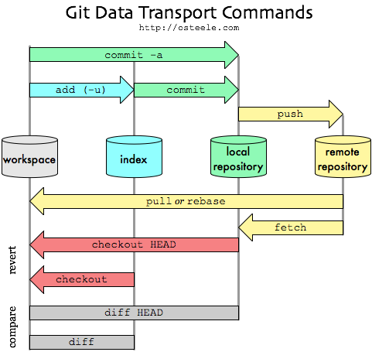
The Big Picture
Now we’ll talk about this part

Slide 82
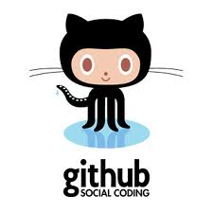
GitHub
Largest open source git hosting site
Public and private options
Public: everyone can see, but must be a collaborator to modify files
Public repos often used for large open source or to distribute libraries etc.
Private: only those you choose as collaborators can see/update
Try it
Log onto github
Walk through the tutorials

Slide 83

Getting an account
Set up a user account
Public account is free
Remember your password!
Get an educational account
Students get 5 private repos
After your account is created, send a discount request (may take a week or so to get a response)
Discount button on: https://education.github.com/
CS collaboration policy
Your homework must be stored in a private repository.

Slide 84
Creating a repo
Option 1
Create repo on github
Add collaborators
Clone onto all machines
Option 2
Use existing repo
Create repo on github
Add collaborators
Set up the connection between existing repo and github repo (called a remote)
Push code onto github
Clone onto other machines

Slide 85
Typical workflow (option 2)
Person A
Setup project & repo
push code onto github
edit/commit
edit/commit
pull/push
Person B
clone code from github
edit/commit/push
edit…
edit… commit
pull/push
This is just the flow, specific commands on following slides.
It’s also possible to create your project first on github, then clone (i.e., no git init)

Slide 86
Remote repository
Remote repository is a bare repository
There is no working directory
Four transfer protocols
http – this is what I recommend/use
local (not covered – good for shared filesystems)
git (not covered – fast but more setup)
SSH (used to be most common)
Use https on the client:
git clone https://github.com/CyndiRader/JavaDemos.git
protocol
userID
repository
When you create a repo on github, it will show you the HTTPS clone URL
Avoid typos: a) copy the URL, b) in git bash, click git-icon/edit/paste OR press Insert.

Slide 87
Create the repo – Option 1
Log onto github
Click on + to add repository
Enter name
Add .gitignore, good to have a README
Click on Settings to control access (Collaborators tab)
On PC, do git clone

Slide 88
Create the repo – Option 2
Create your Java Project
Create your local repo
git init
git commit –m “Initial commit”
Create a repo on github
Add a “shortname” for your git repository
git remote add [shortname] [url]
git remote add origin https://github.com:[user name]/[repository name].git
Ex: git remote add origin https://github.com:CyndiRader/JavaDemos.git
Remember: You can copy/paste the repo url from github
Push your code onto github
git push –u [remote-name] [branch-name].
Ex: git push –u origin master – enter username/password

Slide 89
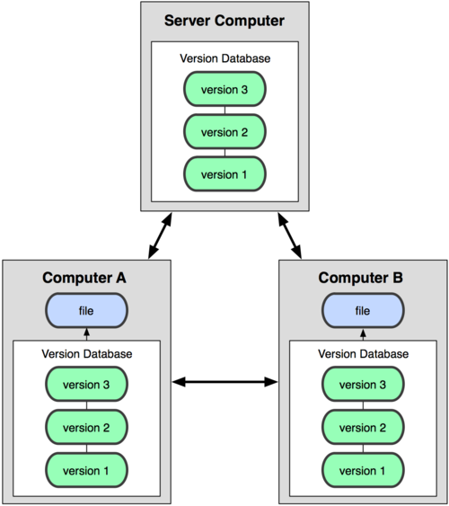
Collaborating via github - cloning
git clone adds the remote repository under the name origin
git clone https://github.com:[user name]/[repository name].git
git clone https://github.com:CyndiRader/JavaDemos.git

Slide 90
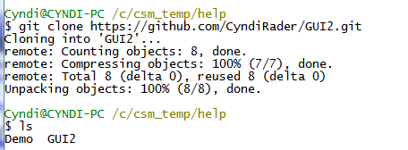
Example

Slide 91
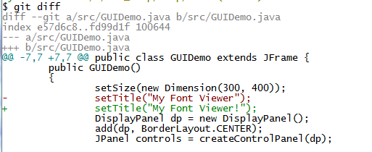
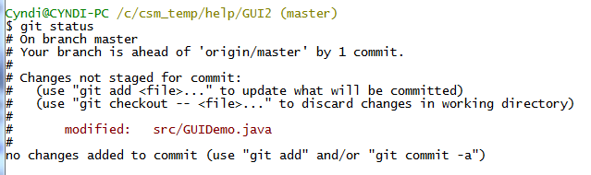
Push example

Slide 92
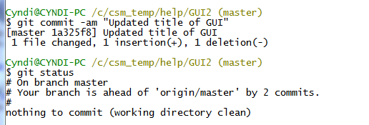
Push example continued
Commit changes – updates local repo

Slide 93
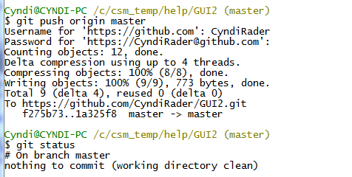
Push example, continued

Slide 94
Keep everyone in synch
Be very careful not to make conflicting changes!
Merge with conflicts covered later
Two options for synchronizing:
Fetch/merge
Pull
Pull is usually simpler, so that’s what we covered.

Slide 95
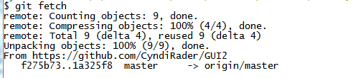
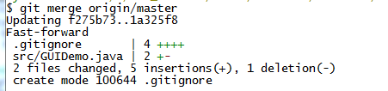
Fetch example - On original machine
Fetch, merge
fast-forward covered under branching

Slide 96
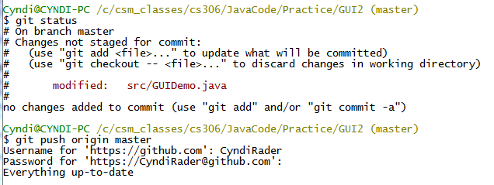
Pull example – on original machine
If you’re careful to avoid conflicts, and you’re working on the master branch, easier to just pull.
Make some changes on original machine
Don’t forget to commit! (see push below, didn’t work)

Slide 97
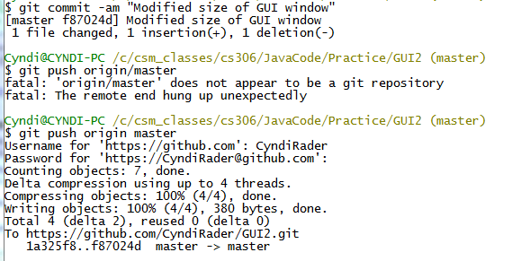
Pull continued
Note typo. git merge origin/master BUT git push origin master.
Merge is specifying the branch to merge (in this case master branch on remote named origin - branches covered in detail later).
Push is specifying the remote and the local branch.
typo

Slide 98
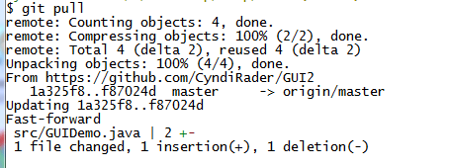
Pull continued – on clone machine
git pull origin master
git pull (assumes origin, master)

Slide 99
A Brief History of Git
Linus uses BitKeeper to manage Linux code
Ran into BitKeeper licensing issue
Liked functionality
Looked at CVS as how not to do things
April 5, 2005 - Linus sends out email showing first version
June 15, 2005 - Git used for Linux version control

Slide 100
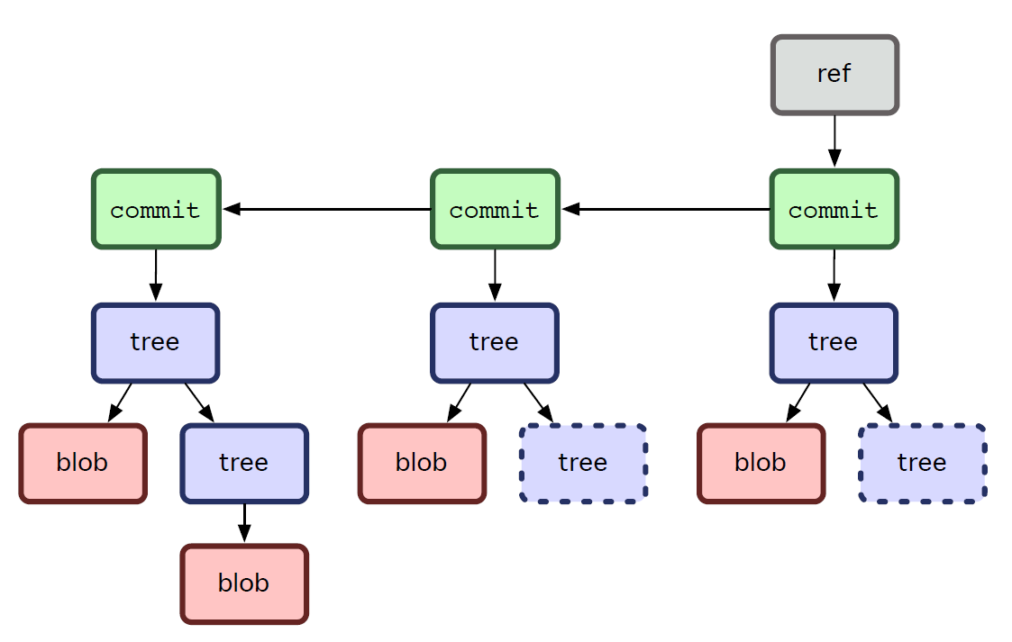
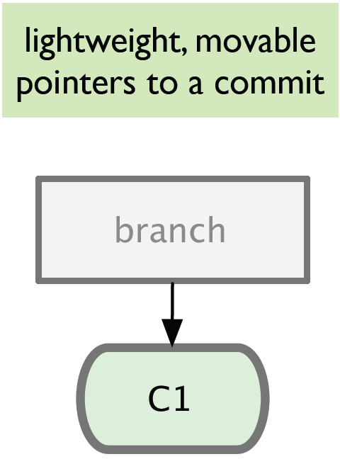
Branching
Git sees commit this way…
Branch annotates which commit we are working on

Slide 101
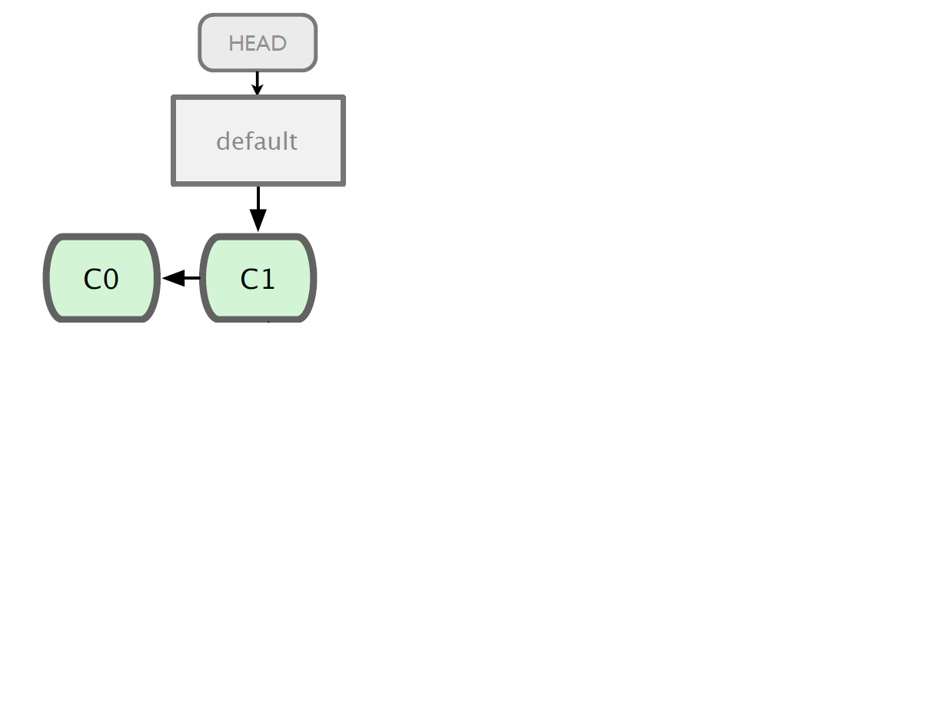
Branching

Slide 102
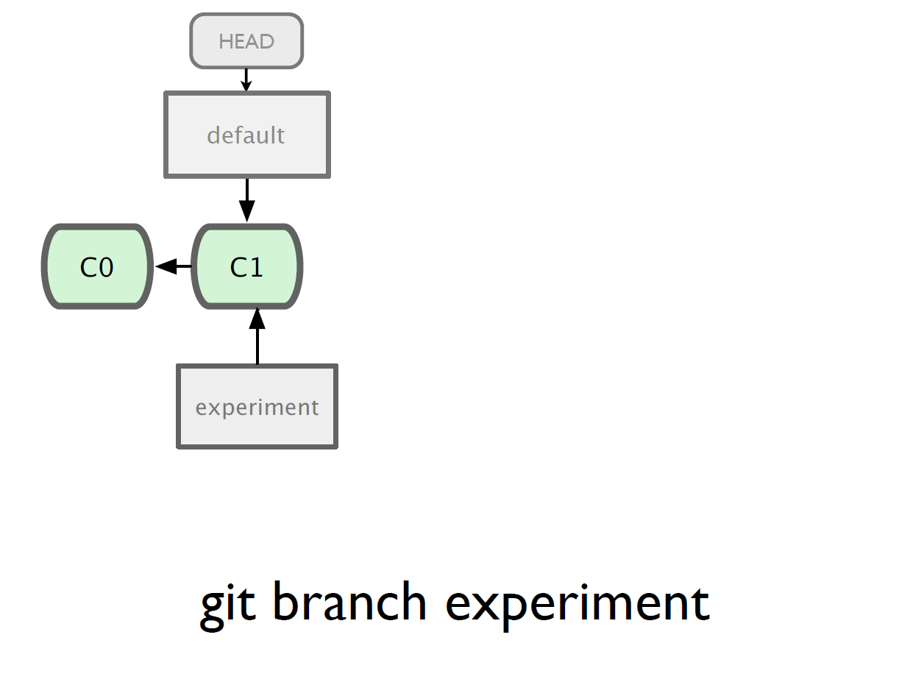

Slide 103
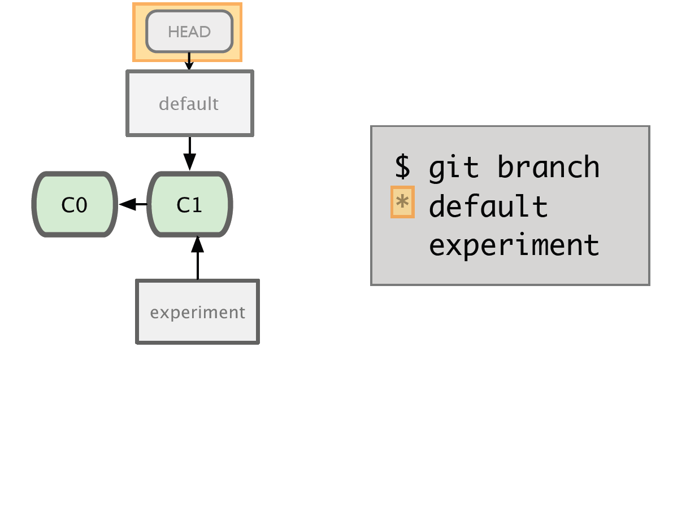

Slide 104
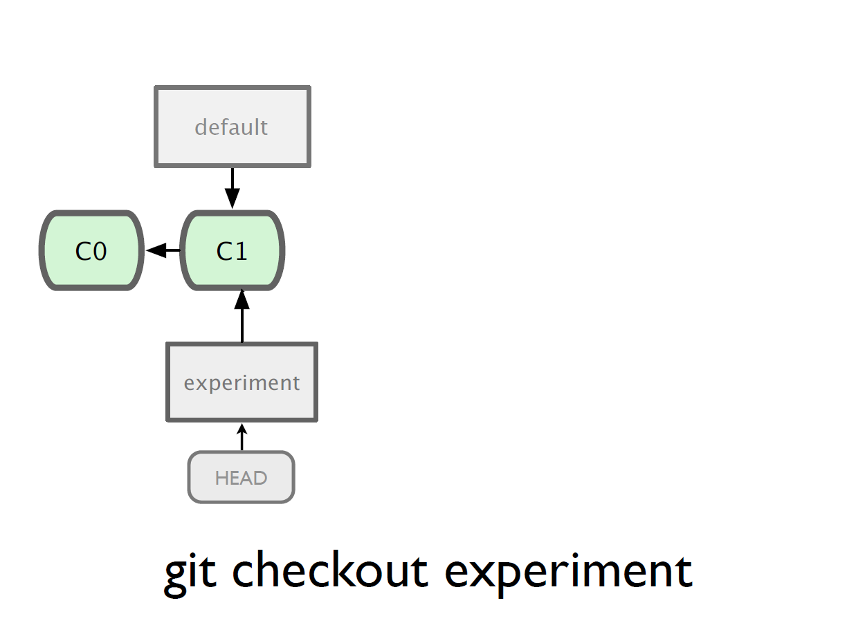

Slide 105
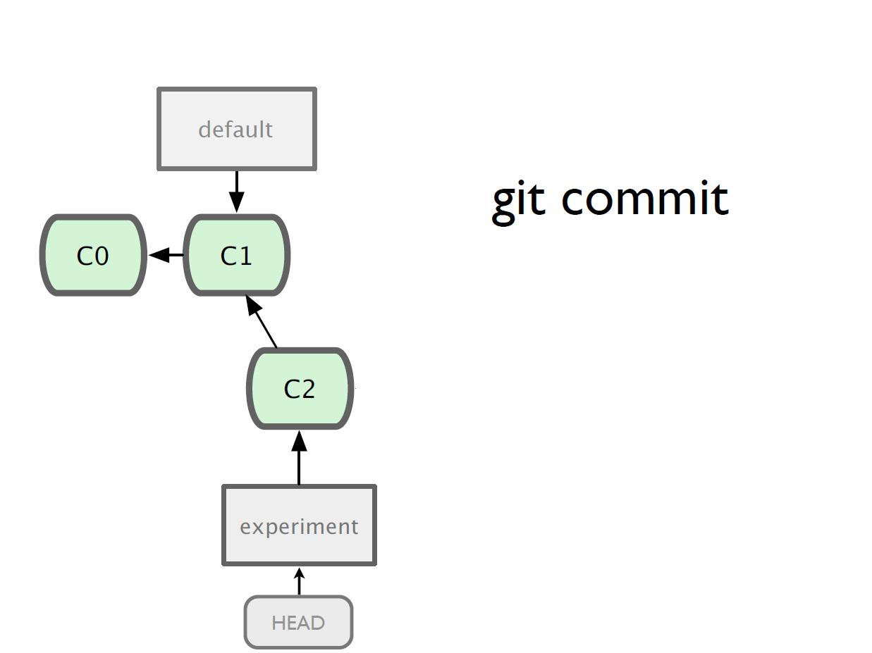

Slide 106
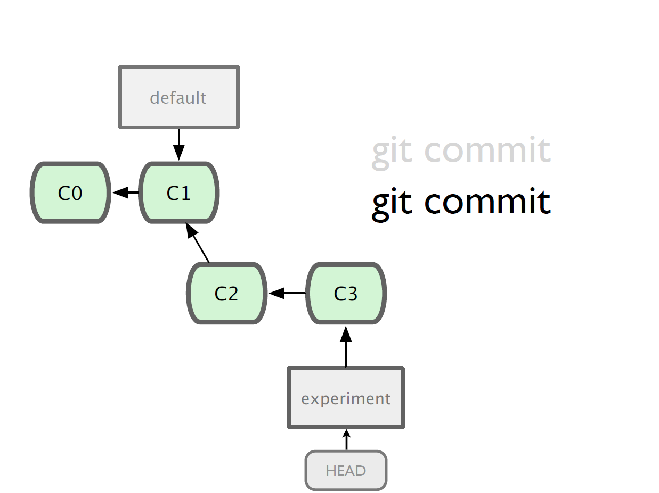

Slide 107
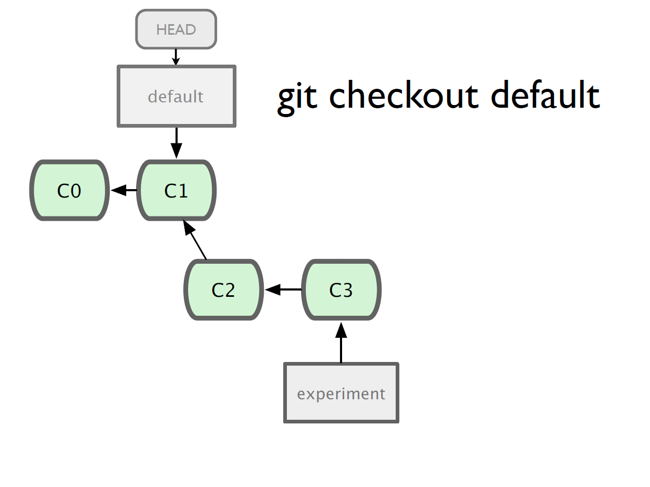

Slide 108
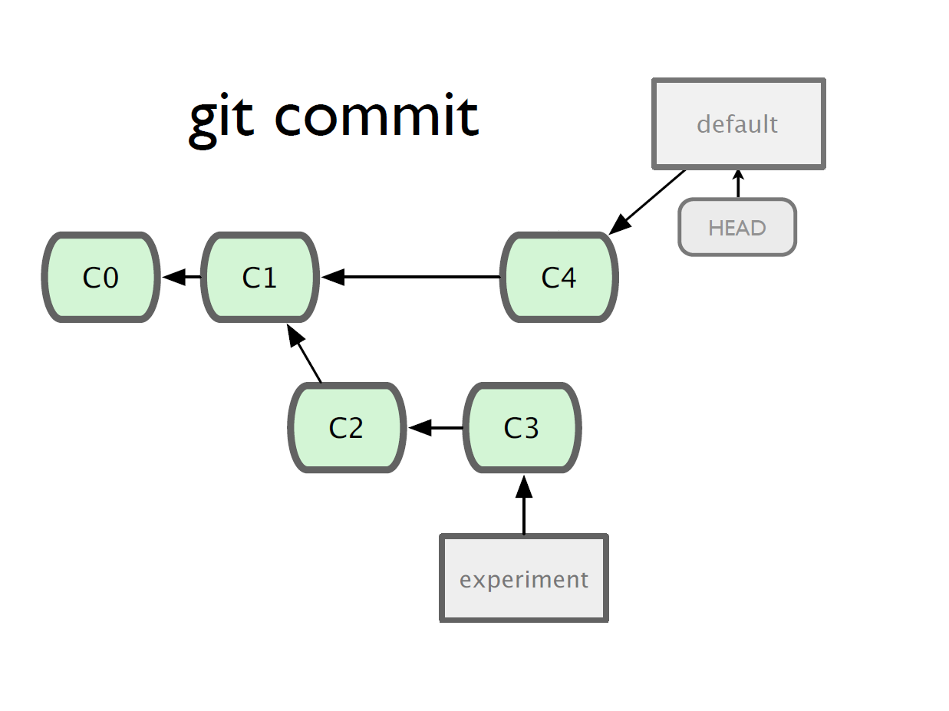

Slide 109
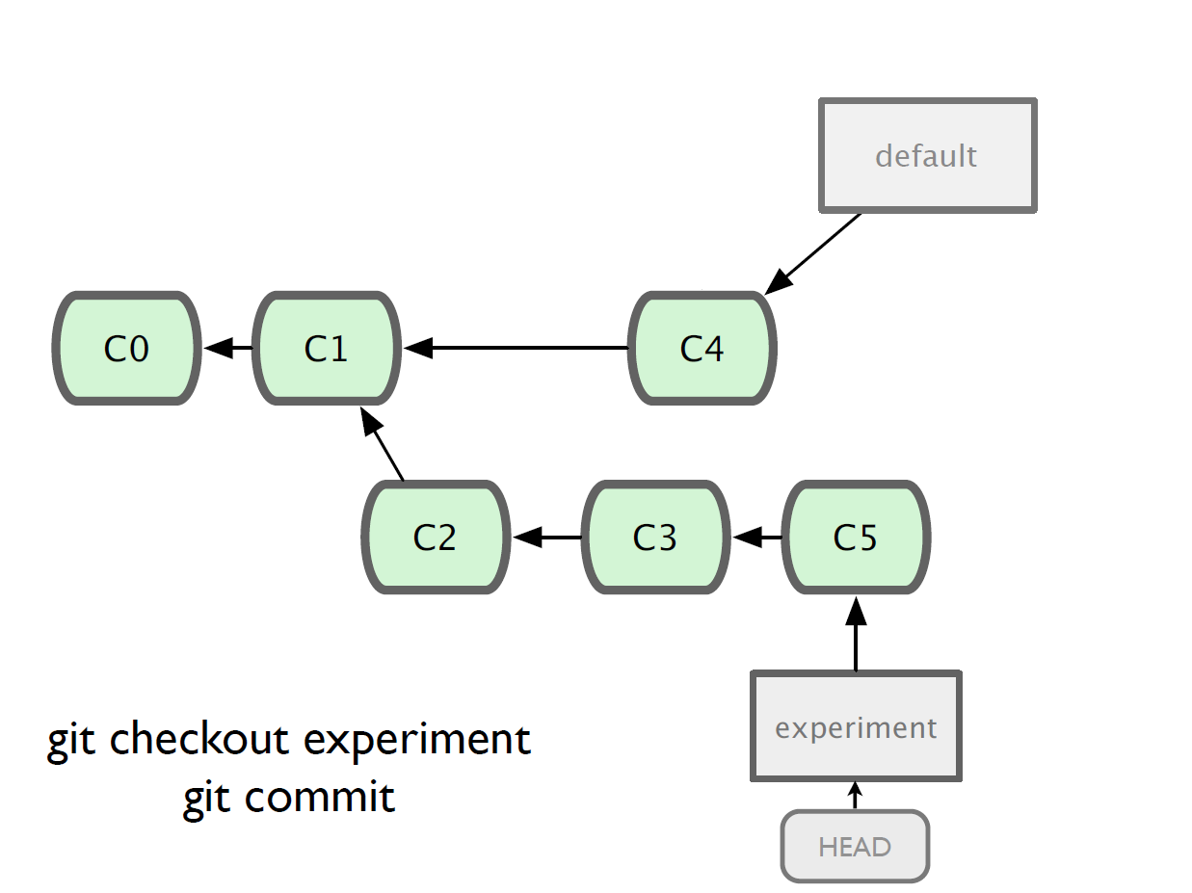

Slide 110
Merging
What do we do with this mess?
Merge them

Slide 111
Merging
Steps to merge two branch
Checkout the branch you want to merge onto
Merge the branch you want to merge

Slide 112
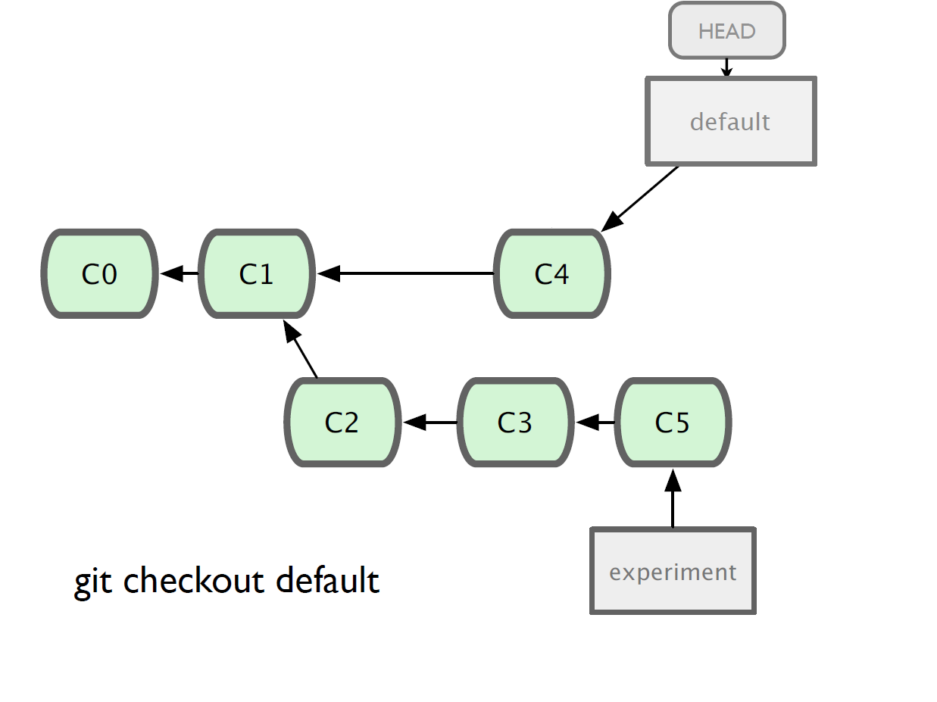

Slide 113
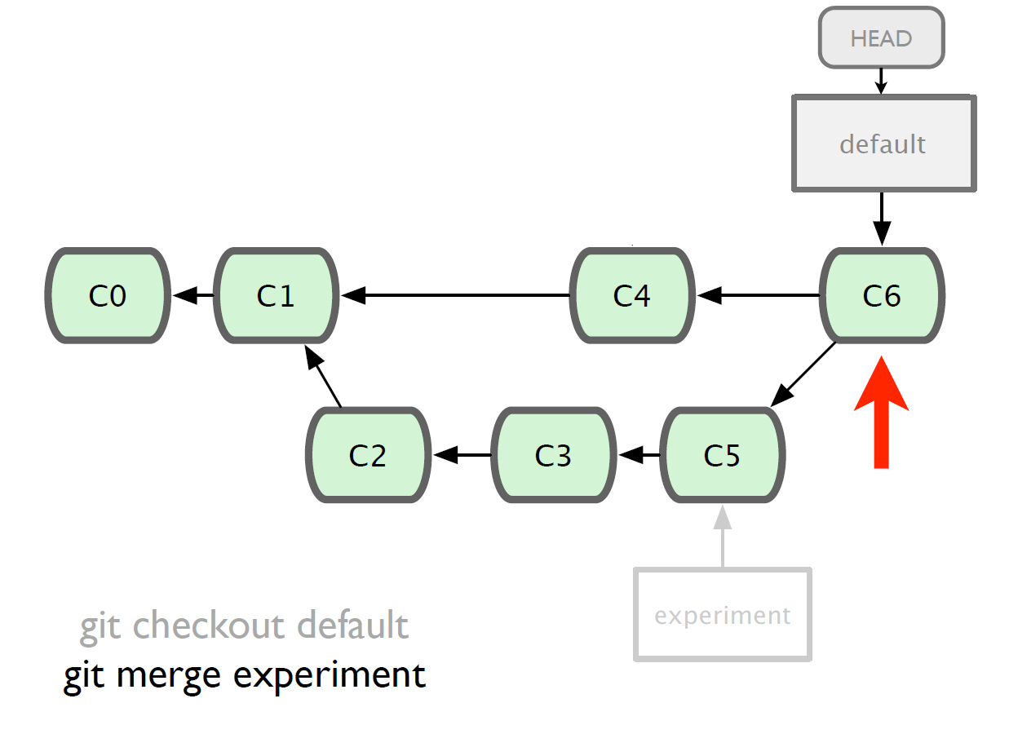

Slide 114
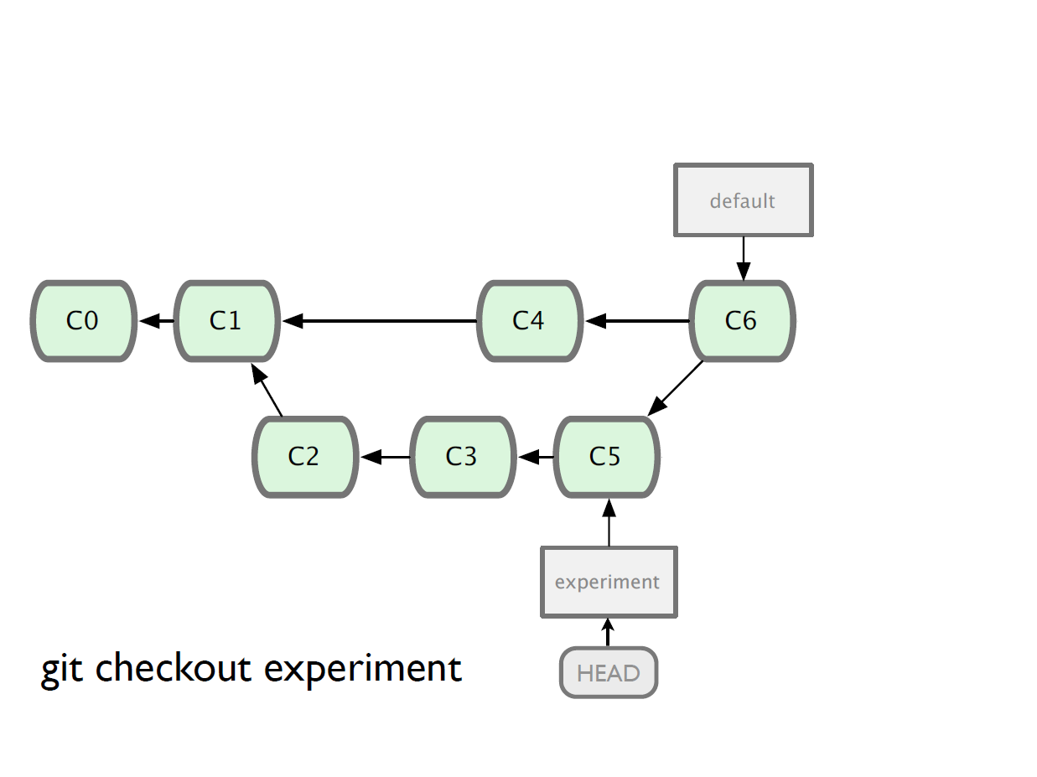

Slide 115
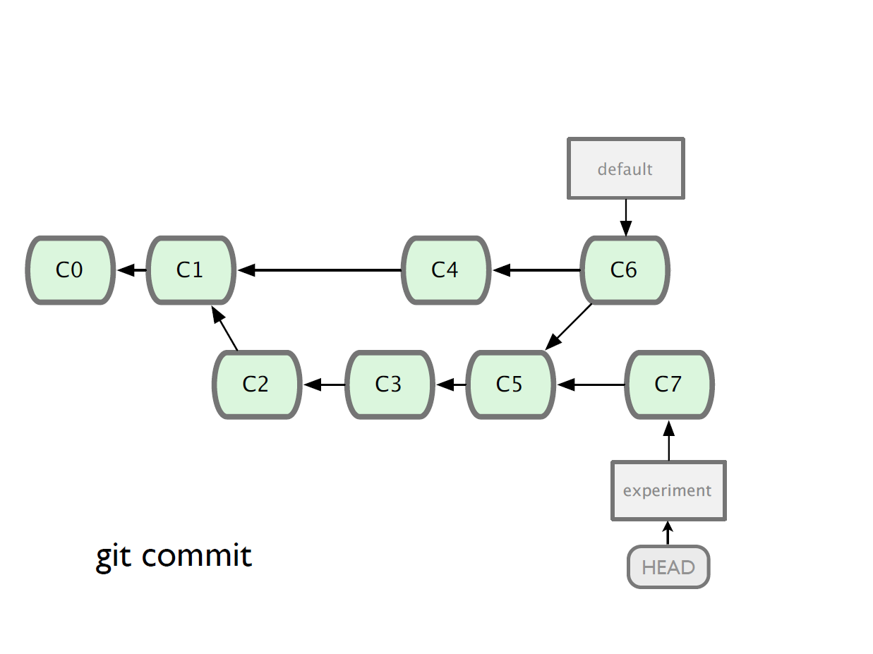

Slide 116
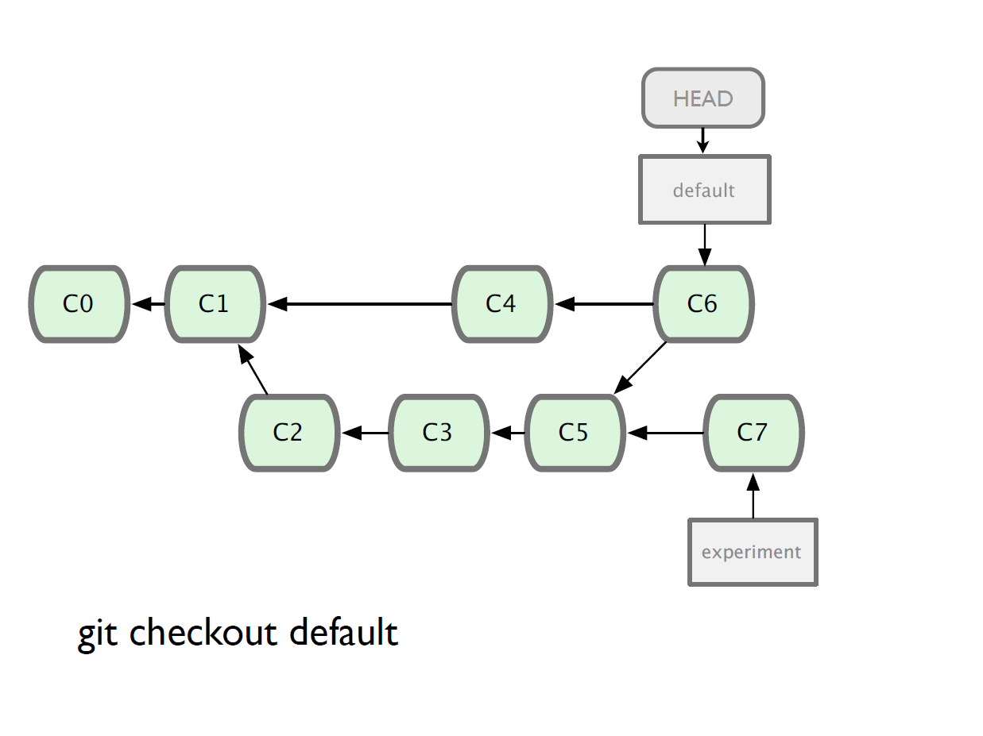

Slide 117
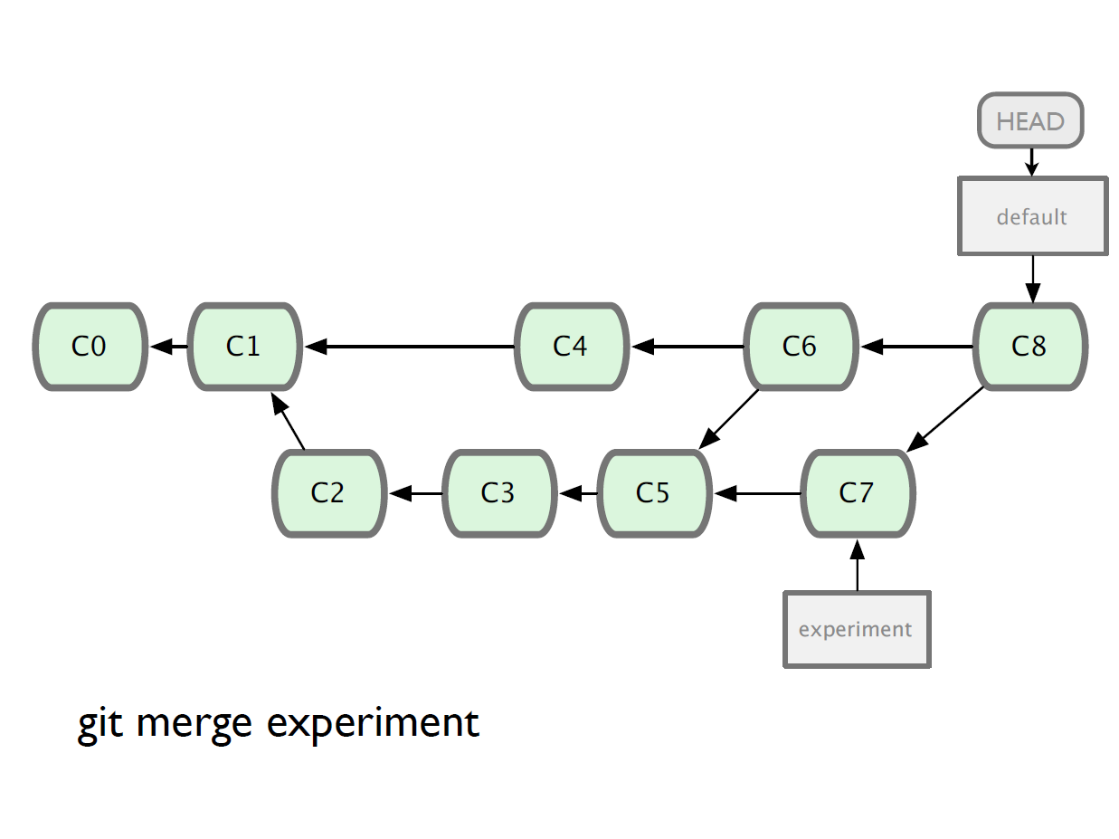

Slide 118
Branching and Merging
Why this is cool?
Non-linear development
clone the code that is in production
create a branch for issue #53 (iss53)
work for 10 minutes
someone asks for a hotfix for issue #102
checkout ‘production’
create a branch (iss102)
fix the issue
checkout ‘production’, merge ‘iss102’
push ‘production’
checkout ‘iss53’ and keep working

Slide 119
Working with remote
Use git clone to replicate repository
Get changes with
git fetch
git pull (fetches and merges)
Propagate changes with
git push
Protocols
Local filesystem (file://)
SSH (ssh://)
HTTP (http:// https://)
Git protocol (git://)

Slide 120
Working with remote Local filesystem
Pros
Simple
Support existing access control
NFS enabled
Cons
Public share is difficult to set up
Slow on top of NFS

Slide 121
Working with remote SSH
Pros
Support authenticated write access
Easy to set up as most system provide ssh toolsets
Fast
Compression before transfer
Cons
No anonymous access
Not even for read access

Slide 122
Working with remote GIT
Pros
Fastest protocal
Allow public anonymous access
Cons
Lack of authentication
Difficult to set up
Use port 9418
Not standard port
Can be blocked

Slide 123
Working with remote HTTP/HTTPS
Pros
Very easy to set up
Unlikely to be blocked
Using standard port
Cons
Inefficient

Slide 124
Working with remote
One person project
Local repo is enough
No need to bother with remote
Small team project
SSH write access for a few core developers
GIT public read access

Slide 125
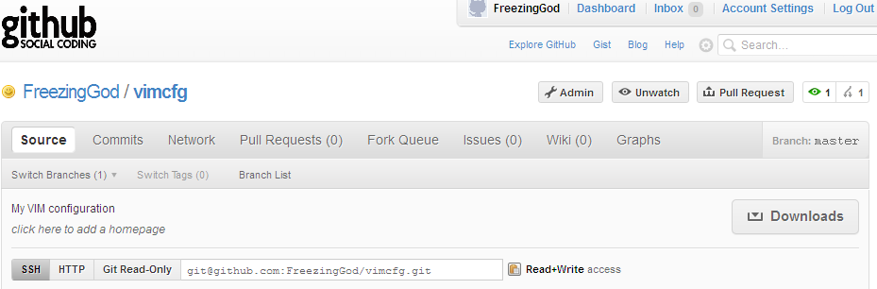
Working with remote
Use git remote add to add an remote repository
Git remote add origin git@github.com:FreezingGod/vimcfg.git
zachary@zachary-desktop:~/.vim_runtime$ git remote
origin

Slide 126
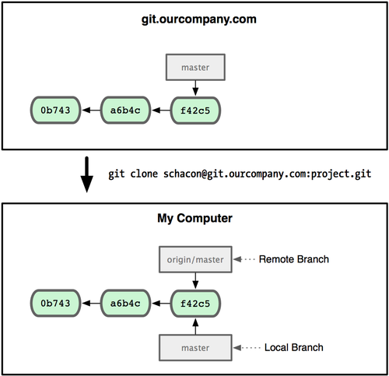
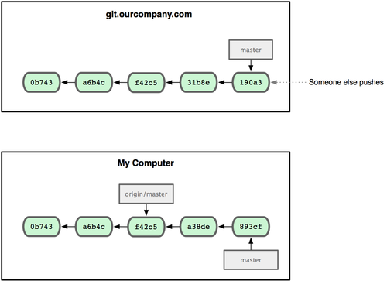
Working with remote
Remote branching
Branch on remote are different from local branch

Slide 127
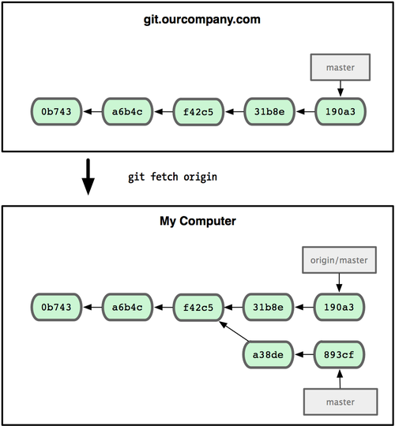
Working with remote
Remote branching
Branch on remote are different from local branch
Git fetch origin to get remote changes
Git pull origin try to fetch reomte changes and merge it onto current branch

Slide 128
Working with remote
Git push remote_name branch_name
Share your work done on branch_name to remote remote_name

Slide 129
Summary
We covered fundamentals of Git
Three trees of git
HEAD, INDEX and working directory
Basic work flow
Modify, stage and commit cycle
Branching and merging
Branch and merge
Remote
Add remote, push, pull, fetch
Other commands
Revert change, history view

Slide 130
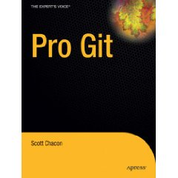
Summary
However, this is by no means a complete portray of git, some advanced topics are skipped:
Rebasing
Commit amend
Distributed workflow
For more information, consult
Official document
Pro Git
Free book available at http://progit.org/book/

Slide 131
3) Maven

Slide 132
Java Build Tool Comparison
Desired Features
The Contenders
Ant + Ivy
Maven
Gradle
Buildr
Others
Results Matrix
Subjective Evaluation
Which Would You Choose?

Slide 133


Results Matrix
Out of the box
Not supported
Desired Feature | Ant + Ivy | Maven | Gradle | Buildr
Dependency management
Versioning | manually
Compile Java code, build jars
Execute tests, report results, fail build on failed tests |  |  | Doesn’t include html reports | Doesn’t include html reports
Run quality check tools (PMD, FindBugs, JavaDoc) | 3rd party task libraries | 3rd party plugins | Manually | Manually
File generation (XmlBeans, XSL, Velocity, AspectJ) | 3rd party task libraries | 3rd party plugins | Manually | Manually

Slide 134
Results Matrix cont’d
Out of the box
Not supported
Desired Feature | Ant + Ivy | Maven | Gradle | Buildr
Property expansion / token substitution
Build vs. deploy vs. release | Manually defined
Full control when needed | Custom XML “scripts” | Write custom plugin or embedded Ant script | Groovy code directly in build file | Ruby code directly in build file
Cross-platform | Runs on JVM | Runs on JVM | Runs on JVM | Runs on Ruby, may need to compile from source
IDE Support |  |  | Eclipse only
Documentation / Support | Excellent | Growing but still inconsistent | Decent project documentation, few articles | Good project documentation, few articles

Slide 135
What is Maven?
For Java
Build Tool
Reporting Tool
Software Distribution
Project
Management

Slide 136
Requirements for Maven
JDK 6+
Maven 2.x
man archetype:generate -DarchetypeArtifactId=maven-archetype-quickstart -DinteractiveMode=false -DgroupId=com.mycompany.app -DartifactId=my-app

Slide 137
Directory Structure
Dir
src
main
test
pom.xml
java
resources
java
resources
com/mycompany/app/App.java
com/mycompany/app/AppTest.java

Slide 138
Directory Structure
Dir
src
main
test
pom.xml
java
resources
java
resources
target
my-app-1.0-SNAPSHOT.jar

Slide 139
Maven Directory Structure
Directory Name Description
src/main/java Application/Library sources
src/main/resources Application/Library resources
src/main/filters Resource filter files
src/main/assembly Assembly descriptors
src/main/config Configuration files
src/main/webapp Web application sources
src/test/java Test sources
src/test/resources Test resources
src/test/filters Test resource filter files
src/site Site
LICENSE.txt Project's license
NOTICE.txt Notices and attributions required by libraries that the
project depends on
README.txt Project's readme

Slide 140
Why Maven?

Slide 141

But Ma, I have Ant?

Slide 142
Project Dependency in Ant
C:\project1
C:\project2
Project 1
Project 2
I only need Project 1, but I still need to checkout Project 2
C:\Project2\dist
Build.xml
Build.xml
Using Relative Path

Slide 143
Checking in Dependencies
Snapshot builds
Project 1
Project 2
Project 3
libs
libs
libs
project2.jar
servlet-api.jar
project3.jar
commons.jar
logging.jar
hamcrest.jar
3rd Party Dependencies are checked in!
What about CIT?

Slide 144
Convention Vs Configuration
Almost Every one is doing following?
Clean
Is it Time to define a
HighLevel
Lifecyle ?
Prepare
Compile
Jar
Test

Slide 145
Custom Ant Tasks
Build Cycle
Project 1
Clean
libs
When to call the task Life cycle?
Compile
project2.jar
servlet-api.jar
android-build.jar
Jar
Dex
APT
What about Reuse?
What about Distribution?

Slide 146
Reporting
Test Run Report
Code Coverage Report
PMD
Can I get these by default?
FindBugs
Change Log
……

Slide 147
Software Distribution
Maven
Spring
Repo
Repo
Xyz..
Repo
Synerzip
Project1
Repo1
Internet
Project2
Repo2
Project3
Repo2

Slide 148
Going Deeper into Maven

Slide 149
pom.xml
<project xmlns="http://maven.apache.org/POM/4.0.0" xmlns:xsi=”….>
<modelVersion>4.0.0</modelVersion>
<groupId>com.mycompany.app</groupId>
<artifactId>my-app</artifactId>
<packaging>jar</packaging>
<version>1.0-SNAPSHOT</version>
<name>my-app</name>
<url>http://maven.apache.org</url>
<dependencies>
<dependency>
<groupId>junit</groupId>
<artifactId>junit</artifactId>
<version>3.8.1</version>
<scope>test</scope>
</dependency>
</dependencies>
</project>

Slide 150
pom.xml
<project xmlns="http://maven.apache.org/POM/4.0.0" xmlns:xsi=”….>
<modelVersion>4.0.0</modelVersion>
<groupId>com.mycompany.app</groupId>
<artifactId>my-app</artifactId>
<packaging>jar</packaging>
<version>1.0-SNAPSHOT</version>
<name>my-app</name>
<url>http://maven.apache.org</url>
<dependencies>
<dependency>
<groupId>junit</groupId>
<artifactId>junit</artifactId>
<version>3.8.1</version>
<scope>test</scope>
</dependency>
</dependencies>
</project>

Slide 151
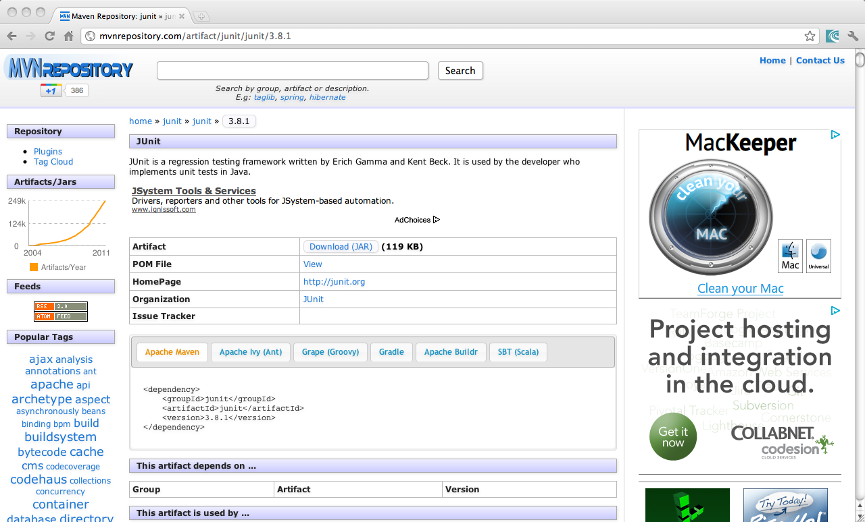

Slide 152
Understanding Repositories
Synerzip
Central
Proxy/Internal Repo
mvn package
~/.m2/repository
mvn install
mvn deploy
Maven Project
Download needed dependencies e.g junit
Install the artifact in to local repository (~/.m2/repository
Push artifact to Internal/Central repository

Slide 153
Maven Architecture
Core
Plugins
Maven Core
compile
compile
Parsing Maven XML File
Maven LifeCycle
Basic Plugins
jar
jar
surefire
test
…
….
…
….

Slide 154
Maven Concepts
Goals
LifeCycle
mvn archetype:generate
mvn install
mvn <<Plugin>>:<<Goal>>
mvn <<LifeCycle Phase>>

Slide 155
Maven Plugins & Goals
Plugin
Goals
compiler
jar
surefire
compile
testCompile
jar
test-jar
sign
Sign-verify
test
Command: mvn help:describe –Dplugin:jar

Slide 156
Maven LifeCycle
Phases
Goals
process-resources
resources:resources
compile
compiler:compile
process-classes
process-test-resources
resources:testResources
test-compile
compiler:testCompile
test
surefire:test
prepare-package
package
jar:jar

Slide 157
mvn clean install
maven-clean-plugin:2.4.1:clean
maven-resources-plugin:2.4.3:resources
maven-compiler-plugin:2.3.2:compile
maven-resources-plugin:2.4.3:testResources
maven-compiler-plugin:2.3.2:testCompile
maven-surefire-plugin:2.7.2:test
maven-jar-plugin:2.3.1:jar
maven-install-plugin:2.3.1:install

Slide 158
Standalone Maven Project

Slide 159
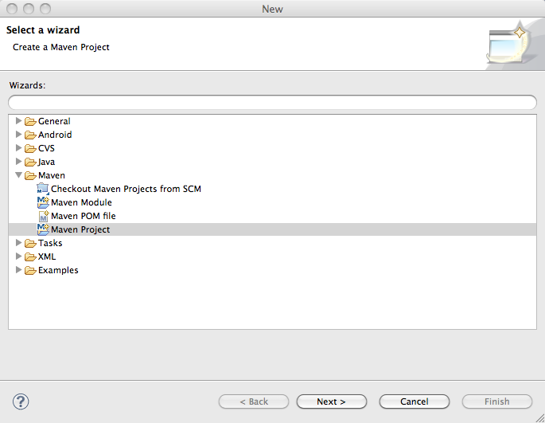

Slide 160
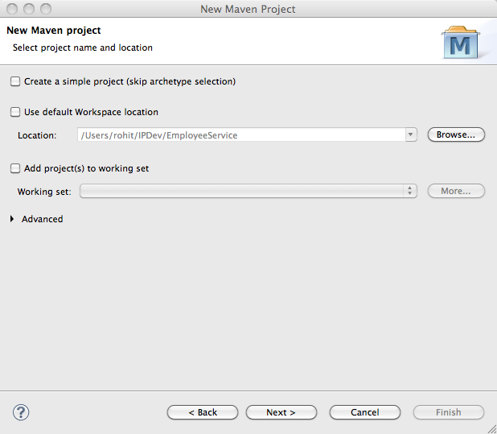

Slide 161
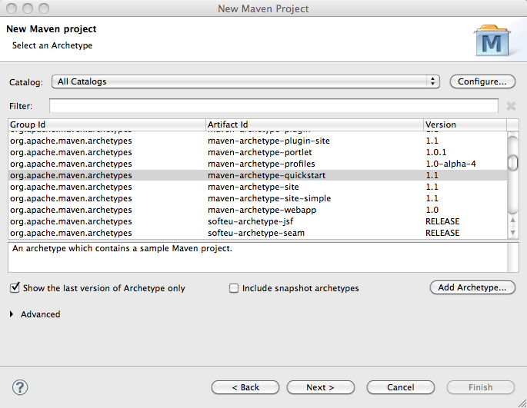

Slide 162


Slide 163


Slide 164
Effective POM

Slide 165


Slide 166
Make Changes
Add Employee Model Class
Add Employee Service (Use Map for persistence)
Add Employee Test Cases
Add Reporting Plugins to generate site

Slide 167
Maven Site Generation

Slide 168
Maven Reporting
<reporting>
<plugins>
<!-- surefire-reports -->
<plugin>
<groupId>org.apache.maven.plugins</groupId>
<artifactId>maven-surefire-report-plugin</artifactId>
<version>2.6</version>
</plugin>
<!-- JavaDoc Plugin -->
<plugin>
<groupId>org.apache.maven.plugins</groupId>
<artifactId>maven-javadoc-plugin</artifactId>
<version>2.8</version>
</plugin>
<!-- jxrsource code browsing plugin -->
<plugin>
<groupId>org.codehaus.mojo</groupId>
<artifactId>jxr-maven-plugin</artifactId>
<version>2.0-beta-1</version>
</plugin>
</reporting>

Slide 169

Maven Site

Slide 170

Maven Site

Slide 171

Maven Site

Slide 172

Maven Site

Slide 173

Maven Site

Slide 174

Maven Site

Slide 175
Maven Site

Slide 176

Maven Site

Slide 177
Maven Web App Project

Slide 178


Slide 179


Slide 180


Slide 181


Slide 182


Slide 183

Web.xml

Slide 184
mvn package tomcat:run-war
Look Ma, No need to download Tomcat by myself

Slide 185


Slide 186
Maven Repositories

Slide 187
Repository Options
Archiva
Artifactory
Nexus

Slide 188
Internal Maven Repositories

Slide 189
<repositories>
<repository>
<id>archiva.internal</id>
<name>Archiva Managed Internal Repository</name>
<url>http://xyz:8080/archiva/repository/internal/</url>
<releases>
<enabled>true</enabled>
</releases>
<snapshots>
<enabled>false</enabled>
</snapshots>
</repository>
<repository>
<id>archiva.snapshots</id>
<name>Archiva Managed Snapshot Repository</name>
<url>http://xyz:8080/archiva/repository/snapshots/</url>
<releases>
<enabled>false</enabled>
</releases>
<snapshots>
<enabled>true</enabled>
</snapshots>
</repository>
</repositories>

Slide 190
Maven Distribution

Slide 191
Distribution Management
<distributionManagement>
<repository>
<id>archiva.internal</id>
<name>Internal Release Repository</name>
<url>dav:http://xyz:8080/archiva/repository/internal/</url>
</repository>
<snapshotRepository>
<id>archiva.snapshots</id>
<name>Internal Snapshot Repository</name>
<url>dav:http://xyz:8080/archiva/repository/snapshots/</url>
</snapshotRepository>
<site>
<id>website</id>
<url>scp://xyz/var/www/mavensite/MavenTraining</url>
</site>
</distributionManagement>

Slide 192
Multi Module Projects

Slide 193
Multi Module Project
employee
<project ….>
<modelVersion>4.0.0</modelVersion>
<groupId>com.technext.maven</groupId>
<artifactId>parent-project</artifactId>
<version>1.0-SNAPSHOT</version>
<packaging>pom</packaging>
<modules>
<module>service</module>
<module>webapp</module>
</modules>
</project>
pom.xml
$employee> mvn package
[INFO] Scanning for projects...
[INFO] Reactor build order:
[INFO] Employee Parent Project
[INFO] Employee-Backend-Services
[INFO] Employee-WebApp
service
pom.xml
webapp
pom.xml

Slide 194
Parent Child Relationship

Slide 195
Parent Child Relationship
employee
<project …>
<modelVersion>4.0.0</modelVersion>
<parent>
<artifactId>employee-parent</artifactId>
<groupId>com.technext.maven.multimodule</groupId>
<version>0.0.1-SNAPSHOT</version>
</parent>
<groupId>com.technext.maven.multimodule</groupId>
<artifactId>employee-service</artifactId>
<version>0.0.1-SNAPSHOT</version>
<name>Employee-Backend-Services</name>
</project>
pom.xml
service
pom.xml
webapp
pom.xml

Slide 196
Maven Profiles

Slide 197
How Often you customize your builds?
Build Portability
Production
Vs
Development
Developer
Vs
QA
Manager
Vs
Individual Contributer
Windows
Vs
Linux

Slide 198
Welcome Maven Profiles

Slide 199


Slide 200


Slide 201


Slide 202
Scenario
CVS
Archiva Server
(Repository Server)
pom.xml
<settings>
...
<servers>
<server>
<id>deployment.webdav</id>
<username>{archiva-deployment-user}</username>
<password>{archiva-deployment-pwd}</password>
</server>
...
</servers>
...
</settings>
<project>
...
<distributionManagement>
<repository>
<id>archiva.internal</id>
<name>Internal Release Repository</name>
<url>dav:http://reposerver.mycompany.com:8080/archiva/repository/internal/</url>
</repository>
<snapshotRepository>
<id>archiva.snapshots</id>
<name>Internal Snapshot Repository</name>
<url>dav:http://reposerver.mycompany.com:8080/archiva/repository/snapshots/</url>
</snapshotRepository>
</distributionManagement>
...
</project>
Where to specify Username and
Password?
settings.xml
pom.xml
pom.xml
pom.xml

